Slide 1
Examine the presentation of Romeo and Juliet. Who is the stronger character?
Act 1 Scene 1: Romeo is presented as a courtly lover (weak)
Act 1 Scene 5: Romeo and Juliet first speak (equal)
Act 2 Scene 2: The balcony scene (Juliet stronger)
Act 3 Scene 5: The morning of their separation (initially Romeo stronger, then Juliet appears stronger)

Slide 2
Act 1 Scene 1
L.O.: To learn how Lord Montague is concerned about his son.
Starter:
List two phrases from the prologue that talk about love.

Slide 3
Act 1 Scene 1: Romeo is depressed about Rosaline
Main Idea: The way that Romeo acts and the way he speaks about his love for Rosaline show his love is very immature. It is not true love.
Key Parts of Story: Lord Montague is concerned about his son Romeo and describes the way he is acting.

Slide 4
Who is Rosaline?
Rosaline is an unseen character in Romeo and Juliet. Although silent, her role is important. Romeo is at first deeply in love with Rosaline and expresses his dismay at her not loving him back.

Slide 5
LORD MONTAGUE
Many a morning hath he there been seen,
With tears augmenting the fresh morning dew.
Adding to clouds more clouds with his deep sighs;
But all so soon as the all-cheering sun
Should in the furthest east begin to draw
The shady curtains from Aurora's bed,
Away from the light steals home my heavy son,
And private in his chamber pens himself,
Shuts up his windows, locks far daylight out
And makes himself an artificial night:
Black and portentous must this humour prove,
Unless good counsel may the cause remove.
How is Romeo acting like a courtly lover?

Slide 6
With tears augmenting the fresh morning dew
private in his chamber pens himself
makes himself an artificial night
Romeo is locking himself in his room like a caged animal.
Romeo keeps everything dark because he is depressed.
Romeo is crying so much he is adding to the dew on the grass in the morning.

Slide 7
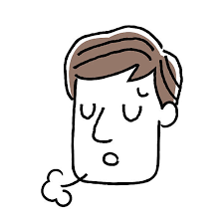
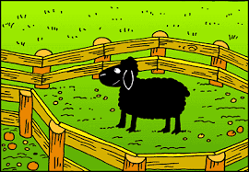
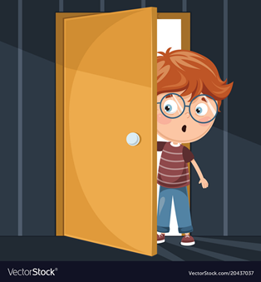
Visualise the Metaphors for Depression Lord Montague Uses
With tears augmenting the fresh morning dew.
Adding to clouds more clouds with his deep sighs;
And private in his chamber pens himself,
Shuts up his windows, locks far daylight out
And makes himself an artificial night:

Slide 8
With tears augmenting the fresh morning dew
1. Lord Montague talks about Romeo’s tears being a dew drop because tears are wet.
2. Lord Montague talks about Romeo’s tears being a dew drop because dew drops are fragile and Romeo is in a fragile emotional state.
private in his chamber pens himself
1. Lord Montague says that Romeo locks himself in his room like an animal because…
2. Lord Montague says that Romeo feels like a caged animal because…
makes himself an artificial night
1. Lord Montague talks about Romeo creating an artificial night because in the day time Romeo…
2. Lord Montague talks about night because Romeo’s mood is…

Slide 9
In Act 1 S……………. 1 Lord Montague expresses his concern about Romeo in a m………………………… to B……………………… He is concerned about Romeo because he is acting like he is d…………………… . This reveals Lord Montague’s love for Romeo as a father but also shows the negative impact u……………………… love has on Romeo.
unrequited scene monologue depressed Benvolio

Slide 10
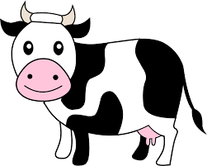
Evidence Suggests “QUOTE” | Firstly, Lord Montague says “with tears augmenting the fresh morning dew”, which suggests that Romeo is often crying and this is concerning his father.
CoW 1 Comment on Words | Shakespeare uses the metaphor “tears augmenting the fresh morning dew” to create an exaggerated image of Romeo weeping so much that it is actually adding to the dew on the ground.
CoW 2 Comment on Words (More!) | Additionally, Shakespeare might use the word “dew” because dew drops are fragile and Romeo is in a very fragile and emotional mood.
C.A.R. Characters/Audience/Relationships | This will help the audience understand Romeo’s character because he seems weak because he is depressed and over emotional. The audience will also get a deeper insight into the relationship between Lord Montague and his son because he is clearly concerned about his son’s state of mind.

Slide 11
Evidence Suggests “QUOTE” | Next, Lord Montague says “private in his chamber pens himself”, which suggests that Romeo is isolating himself and keeping away from others.
CoW 1 Comment on Words | Shakespeare uses the metaphor “in his chamber pens himself” to create an image that Romeo is locking himself away in his room.
CoW 2 Comment on Words (More!) | Additionally, Shakespeare might use the word “pens” because Romeo seems like an animal here. He has seems like an animal because he has locked himself up because he is overwhelmed with emotion. Love has made him like a caged animal.
C.A.R. Characters/Audience/Relationship | The will help the audience understand Romeo’s character because he seems very depressed and unable to deal with his problems. This seems like a very immature way to deal with depression and he is acting like a moody teenager. The audience might also audience the negative impact that Rosaline has on Romeo because his love for Rosaline makes him depressed and antisocial.
Peer Assessment Comments:
*Improve your explanation of what the evidence suggests.
*Add some CoW (Comment on Words).
*Add some C.A.R.
*Make sure you explain about Romeo’s relationship with Rosaline.
*Improve the vocabulary you use in your explanation.

Slide 12
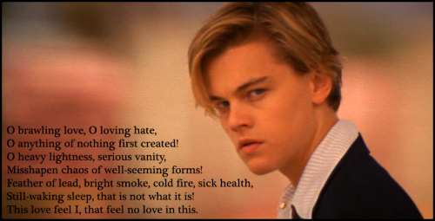
Reasons Why Romeo Uses Oxymorons
*Romeo is confused and his feelings are mixed up so he speaks in contradictory ideas.
*Romeo is depressed that Rosaline does not love his so his mind is jumbled.
*Shakespeare wants the audience to understand that Romeo is acting like a courtly lover so he fills his monologue with oxymorons.
*Romeo is not really in love and his language reveals that he just enjoys sounding clever.
*Shakespeare wants to make Romeo seem pathetic and reveal he is just playing at being in love.
*Romeo might actually enjoy being lovesick because it makes him sound very intellectual.

Slide 13
List the oxymorons.
What fray was here?
Yet tell me not, for I have heard it all.
Here's much to do with hate, but more with love.
Why, then, O brawling love! O loving hate!
O any thing, of nothing first create!
O heavy lightness! serious vanity!
Mis-shapen chaos of well-seeming forms!
Feather of lead, bright smoke, cold fire, sick health!
Still-waking sleep, that is not what it is!
This love feel I, that feel no love in this.

Slide 14
List the oxymorons.
14
What fray was here?
Yet tell me not, for I have heard it all.
Here's much to do with hate, but more with love.
Why, then, O brawling love! O loving hate!
O any thing, of nothing first create!
O heavy lightness! serious vanity!
Mis-shapen chaos of well-seeming forms!
Feather of lead, bright smoke, cold fire, sick health!
Still-waking sleep, that is not what it is!
This love feel I, that feel no love in this.
How do we know that Romeo is using hyperbole?

Slide 15
Romeo’s Depressing Language
L.O. To write a paragraph about Romeo’s depressing language in Act 1 Scene 1.

Slide 16
Love is a smoke made with the fume of sighs:
Being purged, a fire sparkling in lovers’ eyes;
Being vexed, a sea nourished with loving tears.
What is it else? A madness most discreet,
A choking gall
How many negative metaphors?

Slide 17
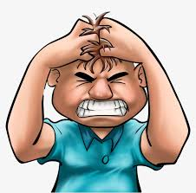
Romeo is Depressed About Love (Depressing Metaphors about Love)
Love is a smoke raised with the fume of sighs;
Smoke clouds your vision. Smoke is dark. Smoke makes it hard to breath.
Being purged, a fire sparkling in lovers' eyes;
Fire can burn you. Fire destroys things.
Being vex'd a sea nourish'd with lovers' tears:
It can make you cry so many tears it will fill the sea.
What is it else? a madness most discreet,
It can drive you crazy.
A choking gall
It can poison you.

Slide 18
Writing a GCSE Paragraph Independently
L.O.: To complete independent work in our first double lesson.
Starter: Please identify if the language below is an oxymoron or metaphor:
1. “Love is a smoke”
2. “O heavy lightness”
3. “Feather of lead, bright smoke, cold fire, sick health”
4. “a fire sparkling in lover’s eyes”
5. “a sea nourished with lovers’ tears”

Slide 19
Evidence Suggests “QUOTE” | Firstly, in his monologue to Benvolio Romeo says “Feather of lead, bright smoke, cold fire, sick health”, which suggests he is confused about love and feeling depressed.
CoW 1 Comment on Words | Shakespeare uses several oxymorons like “feather of lead” and “bright smoke” to make Romeo’s language sound quite muddled as he is juxtaposing opposite words.
CoW 2 Comment on Words (More!) | Additionally, Shakespeare might have Romeo use so many oxymorons because courtly lovers often used oxymorons in their love poetry.
C.A.R. Characters/Audience/Relationships | The will help the audience understand Romeo’s character because he seems so confused by his strong feelings of love. Love is supposed to make you joyful but his rejection by Rosaline means that love makes Romeo feel pain. The oxymorons show that confusion that is in Romeo’s mind. The audience might also recognise negative impact that Rosaline has on Romeo because he is acting like a courtly lover and he does not sound that sincere. Although the oxymorons he uses sounds clever, the audience will realise that he is just acting like a typical courtly lover and his feelings are not that sincere.

Slide 20
Act 1 Scene 5: Romeo and Juliet’s First Conversation
L.O.: To learn how Shakespeare shows that Romeo and Juliet were meant for each other.

Slide 21
Romeo and Juliet are finishing each other’s sentences the first time they meet. Their first conversation makes a perfect sonnet.
This conversation makes Romeo and Juliet seem…
The audience might realise that Romeo and Juliet are…

Slide 22
ROMEO [To JULIET]
If I profane with my unworthiest hand This holy shrine, the gentle sin is this: My lips, two blushing pilgrims, ready stand To smooth that rough touch with a tender kiss.
JULIET
Good pilgrim, you do wrong your hand too much, Which mannerly devotion shows in this; For saints have hands that pilgrims’ hands do touch, And palm to palm is holy palmers’ kiss.
ROMEO
Have not saints lips, and holy palmers too?
JULIET
Ay, pilgrim, lips that they must use in prayer.
ROMEO
O, then, dear saint, let lips do what hands do; They pray, grant thou, lest faith turn to despair.
JULIET
Saints do not move, though grant for prayers’ sake.
ROMEO
Then move not, while my prayer’s effect I take.
Romeo calls Juliet a holy shrine.
This makes it seem like Romeo is worshipping Juliet.
Juliet calls Romeo a pilgrim.
This shows that Juliet is also using religious language like Romeo and is flirting along with him.
Romeo calls his kiss a prayer.
Romeo and Juliet speak in a perfect sonnet.
This makes them seem like they are made for each other because their words match perfectly.

Slide 23
Act 2 Scene 2
L.O.: To analyse the relationship between Romeo and Juliet in this scene.

Slide 24
But, soft! what light through yonder window breaks? It is the east, and Juliet is the sun.
Two of the fairest stars in all the heaven, Having some business, do entreat her eyes To twinkle in their spheres till they return. What if her eyes were there, they in her head? The brightness of her cheek would shame those stars, As daylight doth a lamp; her eyes in heaven Would through the airy region stream so bright That birds would sing and think it were not night. See, how she leans her cheek upon her hand! O, that I were a glove upon that hand, That I might touch that cheek!
Juliet is so bright she is like the sun.
*The stars are asking Juliet’s eyes to twinkle for them because the are so bright.
*Juliet’s eyes are so bright they would make the stars feel ashamed and the birds would think it is daytime.
*I wish I were a glove on Juliet’s hand.

Slide 25
Juliet
How camest thou hither, tell me, and wherefore? The orchard walls are high and hard to climb, And the place death, considering who thou art, If any of my kinsmen find thee here.
If they do see thee, they will murder thee.
Romeo
With love's light wings did I o'er-perch these walls; For stony limits cannot hold love out, And what love can do that dares love attempt; Therefore thy kinsmen are no let to me.
I have night's cloak to hide me from their sight; And but thou love me, let them find me here: My life were better ended by their hate, Than death prorogued, wanting of thy love.

Slide 26
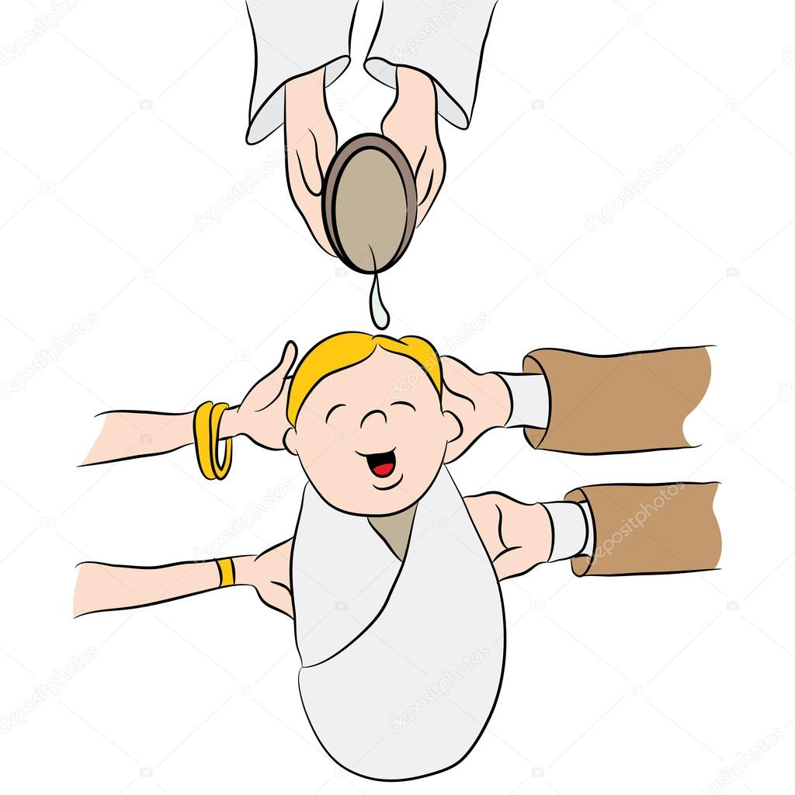
“But, soft! what light through yonder window breaks?
It is the east, and Juliet is the sun.”
“Call me but love, and I'll be new baptized;
Henceforth I never will be Romeo.”
“With love's light wings did I over-perch these walls;
For stony limits cannot hold love out,
And what love can do that dares love attempt;
Therefore thy kinsmen are no stop to me.”

Slide 27
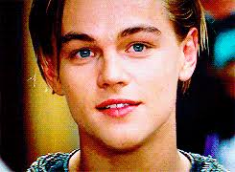
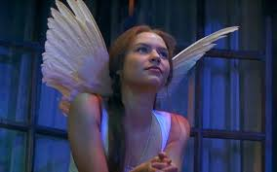
ROMEO
Lady, by yonder blessed moon I swear
That tips with silver all these fruit-tree tops--
JULIET
O, swear not by the moon, the inconstant moon,
That monthly changes in her circled orb,
Lest that thy love prove likewise variable.
ROMEO
What shall I swear by?
JULIET
Do not swear at all;
Or, if thou wilt, swear by thy gracious self,
Which is the god of my idolatry,
And I'll believe thee.
ROMEO
If my heart's dear love--
JULIET
Well, do not swear: although I joy in thee,
I have no joy of this contract to-night:
It is too rash, too unadvised, too sudden;
Too like the lightning.
Swear = to promise
passionate thoughtful rash devoted considered
rational infatuated confident desperate
irrational strong weak

Slide 28
Deny thy father and refuse thy name; Or, if thou wilt not, be but sworn my love, And I'll no longer be a Capulet.
O, be some other name! What's in a name? that which we call a rose By any other name would smell as sweet; So Romeo would, were he not Romeo called, Retain that dear perfection which he owes Without that title.
*Juliet wishes Romeo would…
*Juliet is willing to…
*Juliet wishes that Romeo had a different name than Montague. She thinks that names do not mean anything.
*Even if Romeo were not called Romeo he would still be perfect. She calls him perfect which shows her true feelings for him.

Slide 29
Juliet’s Feelings
Overwhelmed by love
Sensible and Cautious
Ay me!
If they do see thee, they will murder thee.
be but sworn my love, and I'll no longer be a Capulet
O, swear not by the moon, the inconstant moon
I have no joy of this contract to-night:
It is too rash, too unadvised, too sudden;
Too like the lightning.

Slide 30
Evidence Suggests “QUOTE” | Firstly, when Juliet first appears in Act 2 Scene 2 she says “O, be some other name!” which suggests that Juliet wishes Romeo were not a Montague.
CoW 1 Comment on Words | Shakespeare uses the uses the word “O” to show that Juliet is desperate and she is exclaiming this idea passionately. She also thinks she is alone so she is revealing her strong and sincere feelings by exclaiming this line.
CoW 2 Comment on Words (More!) | Additionally, Shakespeare has Juliet use the word “name” to show that it is the “name” Montague that is the problem here. The man has a “name” that complicates the situation because the family are rivals.
C.A.R. Characters/Audience/Relationships | The will help the audience understand Juliet’s character because we understand how strong her feelings are when she thinks no one is listening. She is overwhelmed by her passion for Romeo and she is almost shouting to herself. The audience might also recognise that the relationship between Juliet and Romeo faces many obstacles that the characters often agonise over. Here, Juliet demonstrates that their family rivalry makes her feelings complex. It is ironic that the man she falls in love with is supposed to be her enemy.

Slide 31
Later in Act 2 Scene 2 Juliet says “O, swear not by the moon, the inconstant moon”, which suggests that Juliet is being more sensible than Romeo because she does not want him to promise to love her without taking it seriously. Juliet uses the word “swear” because she is referring to Romeo’s promise to love her. Additionally, Juliet uses the word “moon” because she does not want Romeo to swear on the “moon” because the moon is always changing and Juliet never wants Romeo’s feelings to change. The audience might realise that Juliet is a strong character here because she is demanding sincerity from Romeo and she does not want him to lightly promise her his love. The audience might also understand that the relationship between Romeo and Juliet is rather surprising as he seems overwhelmed whereas she seems more sensible and in control of the situation. She does not want to settle for promise that does not really mean anything.

Slide 32
I have fallen for you too quickly so you might think I am insincere. Trust me and I will prove my love to you.
JULIET
In truth, fair Montague, I am too fond,
And therefore thou mayst think my behavior light:
But trust me, gentleman, I'll prove more true
Than those that have more cunning to be strange.
JULIET
If that thy bent of love be honourable,
Thy purpose marriage, send me word to-morrow,
By one that I'll procure to come to thee,
Where and what time thou wilt perform the rite;
And all my fortunes at thy foot I'll lay
And follow thee my lord throughout the world.
If you are a decent man and intend to marry me, tell me tomorrow when and where we will get married. I will put my trust in you and follow you.

Slide 33
“Juliet exhibits determination and strength rather beyond Romeo. It is she, rather than he, who is in charge.”
Or
“It is her love for a man which gives her this strength.”

Slide 34
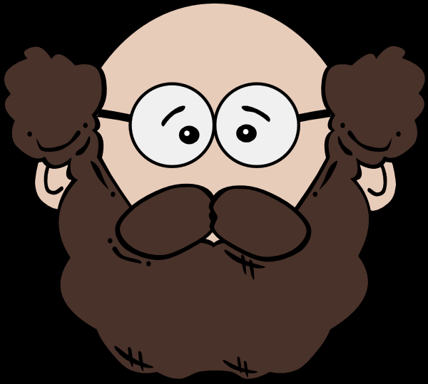
Obviously a young girl in Elizabethan times has no actual power.
Juliet is more cautious and has more control over her feelings.
Bruce
Sally
Juliet is a stronger character than Romeo.
Romeo and Juliet seem more like equals to me.
Mary
Outcome: Reach a consensus within your group.

Slide 35
Act 3 Scene 5
Romeo and Juliet must separate the morning after their wedding night.

Slide 36
JULIET
Wilt thou be gone? it is not yet near day:
It was the nightingale, and not the lark,
That pierced the fearful hollow of thine ear;
Nightly she sings on yon pomegranate-tree:
Believe me, love, it was the nightingale.
ROMEO
It was the lark, the herald of the morn,
No nightingale: look, love, what envious streaks
Do lace the severing clouds in yonder east:
Night's candles are burnt out, and jocund day
Stands tiptoe on the misty mountain tops.
I must be gone and live, or stay and die.
Juliet uses a question to plead with Romeo to stay.
Juliet insists it is not even ‘near day’ even though the sun is rising. She is exaggerating.
Juliet says the bird they hear is the ‘nightingale’ – a symbol of the night, not the lark – a symbol of the day
Romeo’s language is beautiful as he uses a metaphor ‘Night’s candles are burnt out’ for the disappearing starts, personification with ‘jocund day stands tiptoe on the misty mountain tops’ and alliteration ‘misty mountain’ but he is actually being very practical here. He is saying that day is actually here.
Romeo uses a blunt, monosyllabic statement to clearly state the situation.

Slide 37
ROMEO
Let me be taken, let me be put to death;
I am content, so thou wilt have it so.
I'll say yon grey is not the morning's eye,
'Tis but the pale reflex of Cynthia's brow;
Nor that is not the lark, whose notes do beat
The vaulty heaven so high above our heads:
I have more care to stay than will to go:
Come, death, and welcome! Juliet wills it so.
Romeo uses a rhyming couplet to show that he actually does not fear death and would rather stay with Juliet.
Romeo personifies death and actually uses the word ‘welcome’ to show he is not afraid.
ROMEO
How is it, my soul? Let's talk; it is not day.
JULIET
It is, it is: hie hence, be gone, away!
Romeo and Juliet share a rhyming couplet. Usually this shows how the couple are speaking in harmony but they contradict each other here. Romeo is willing to pretend it is not day but Juliet finally snaps back to reality and realises he must leave.
Juliet using a tripling of imperatives to order Romeo to leave.

Slide 38
JULIET
O, now be gone; more light and light it grows.
ROMEO
More light and light; more dark and dark our woes!
Romeo and Juliet share a rhyming couplet again. There thinking is in complete harmony now as they are both experiencing the painful reality that Romeo must leave.
Shakespeare makes effective use of antithesis here by contrasting ‘light’ and ‘dark’. Usually ‘light’ symbolises something positive but the increasing ‘light’ of day is actually making their lives ‘dark’ because they have to leave each other.
JULIET
O God, I have an ill-divining soul!
Methinks I see thee, now thou art below,
As one dead in the bottom of a tomb
Juliet has a premonition of Romeo’s death. Does she have a clearer understanding that they are ‘star-crossed’ lovers, as mentioned in the prologue?

Slide 39
Evidence Suggests “QUOTE” | Firstly, when Romeo and Juliet wake up after spending the night together Juliet says “Wilt thou be gone? it is not yet near day: it was the nightingale, and not the lark”, which suggests that Juliet is in denial that Romeo has to leave.
CoW 1 Comment on Words | Shakespeare has Juliet use a question “Wilt thou be gone?” to make it seem like Juliet is pleading with Romeo to stay. It is obvious that he has to go and using a question makes it seem like she is almost begging him to stay.
CoW 2 Comment on Words (More!) | Additionally, Shakespeare has Juliet use the names of bird, “nightingale” and “dark” to symbolise night and morning. By emphasising that it was “the nightingale”, which is a symbol of the night, Juliet is trying to convince herself that it is not morning.
C.A.R. Characters/Audience/Relationships | The will help the audience understand Juliet’s character because she is usually practical and thinking clearly but here she is seems to be overwhelmed with her emotions and is desperate for Romeo to stay, no matter what the consequences. The audience might also see how the relationship between Juliet and Romeo is getting even more intense because of her strong feelings of love after they have spent the night together.

